Slide 1



Fall 2020
Advanced Affective Neuroscience
CHOONG-WAN WOO | COCOAN lab | http://cocoanlab.github.io

Slide 2
Affective Neuroscience | Fall 2020
Lecture 02
Lecture 02
Affective Neuroscience
Interrupt me any time!
Ask questions any time!
Dispute me any time!
CHOONG-WAN WOO | COCOAN lab | http://cocoanlab.github.io

Slide 3
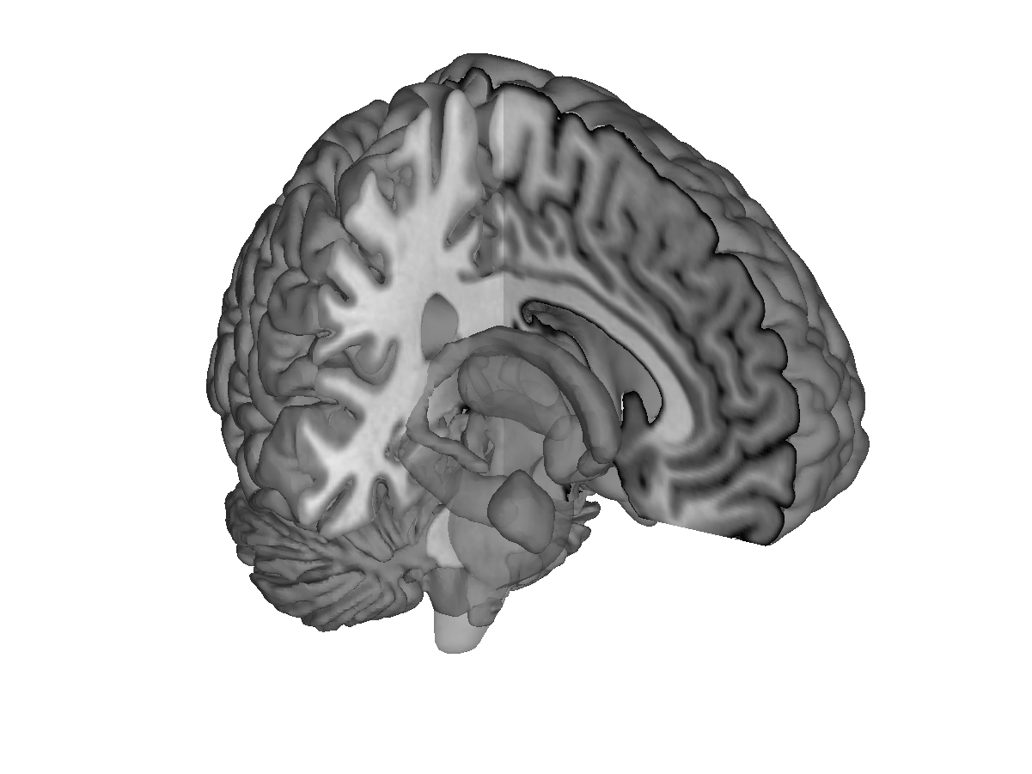
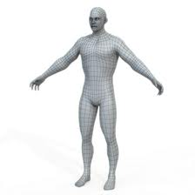

Slide credit: Tor Wager
What is affective neuroscience?
Affective neuroscience?
Study of human brain systems related to:
Emotion
Self
Pain and pleasure
Value and decision-making
Visceral sensations
Social cognition
Mind-brain-body communication
Brain health disorders (Parkinson’s, chronic pain, PTSD)
Physical health and well-being
Brain
Interoception
Behavior
Sensation
Visceral
regulation
Body
Environmental
exposure
Social environment
Physical environment
CHOONG-WAN WOO | COCOAN lab | http://cocoanlab.github.io

Slide 4
Slide credit: Tor Wager
What is affective neuroscience?
Affective neuroscience?
Study of human brain systems related to:
Emotion
Self
Pain and pleasure
Value and decision-making
Visceral sensations
Social cognition
Mind-brain-body communication
Brain health disorders (Parkinson’s, chronic pain, PTSD)
Physical health and well-being
Human
Neuroscience
Affective neuroscience
Systems
Neuroscience
Computation and
statistics
Cognitive and Social Psychology
CHOONG-WAN WOO | COCOAN lab | http://cocoanlab.github.io

Slide 5
Slide credit: Tor Wager
What is affective neuroscience?
Affective neuroscience?
Study of human brain systems related to:
Emotion
Self
Pain and pleasure
Value and decision-making
Visceral sensations
Social cognition
Mind-brain-body communication
Brain health disorders (Parkinson’s, chronic pain, PTSD)
Physical health and well-being
Human
Neuroscience
Affective neuroscience
Systems
Neuroscience
Computation and
statistics
Cognitive and Social Psychology
CHOONG-WAN WOO | COCOAN lab | http://cocoanlab.github.io

Slide 6
What is emotion?
CHOONG-WAN WOO | COCOAN lab | http://cocoanlab.github.io

Slide 7

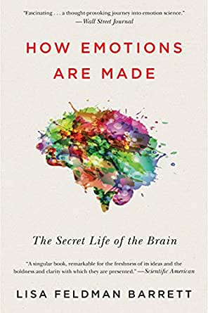
What is emotion?
“It is widely agreed that emotion refers to a collection of psychological states that include subjective experience, expressive behavior (e.g., facial, bodily, verbal), and peripheral physiological responses (e.g., heart rate, respiration).”
“It is also widely agreed that emotions are a central feature in any psychological model of the human mind.”
“Beyond these two points of agreement, however, almost everything else seems to be subject to debate.”
“What is emotion” depends on the emotion theory you hold
CHOONG-WAN WOO | COCOAN lab | http://cocoanlab.github.io
Barrett, 2017

Slide 8
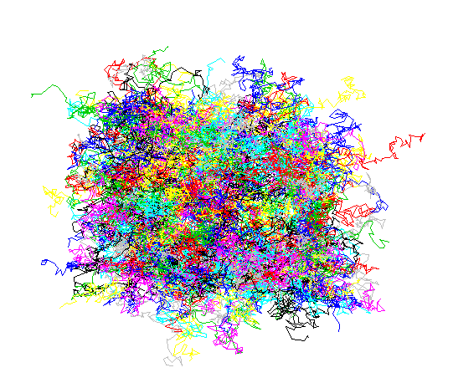
Emotion
Something very high-dimensional and complicated
Emotion can be different depending on which directions or perspectives you view the emotion from
CHOONG-WAN WOO | COCOAN lab | http://cocoanlab.github.io

Slide 9
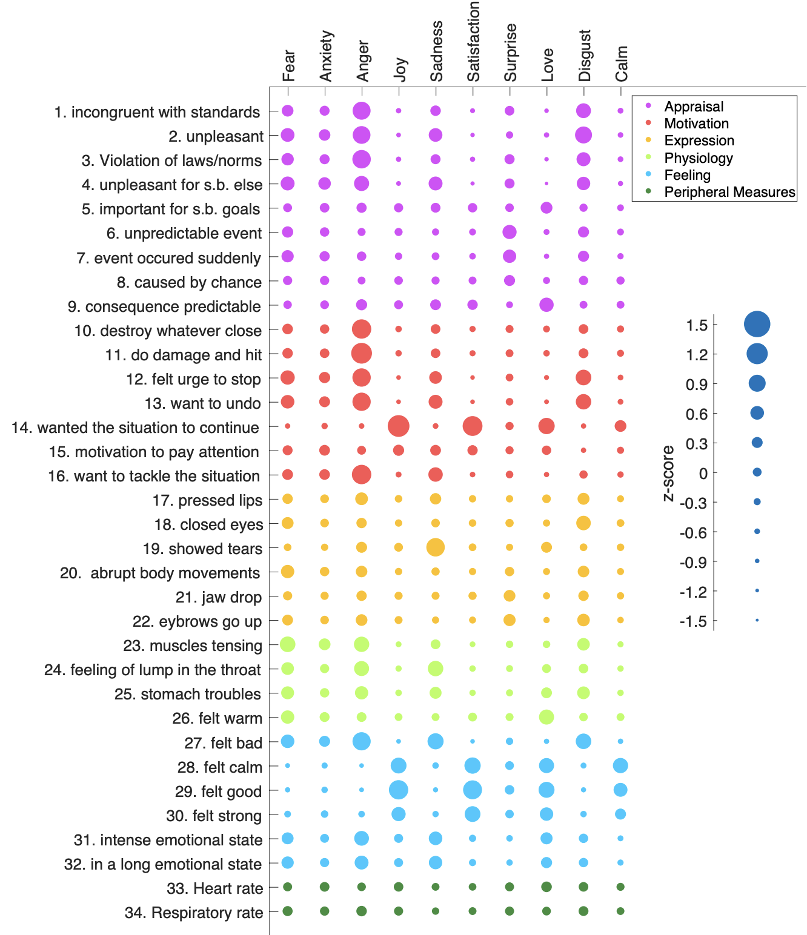

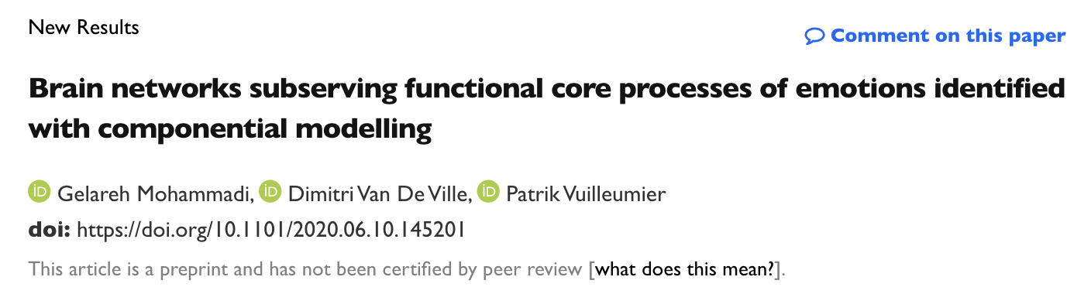
Component model of emotion
https://www.biorxiv.org/content/10.1101/2020.06.10.145201v1
CHOONG-WAN WOO | COCOAN lab | http://cocoanlab.github.io

Slide 10
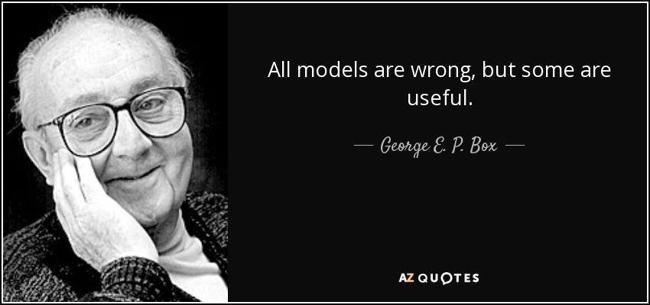
Dimension reduction of emotions, why and how?
We need to reduce the dimensionality of emotions to better understand the emotions
But we also need to remember that emotions are complex and high dimensional, meaning there could be multiple answers to emotion
The main goal of emotion research should be to find useful theories and models
CHOONG-WAN WOO | COCOAN lab | http://cocoanlab.github.io

Slide 11
Emotion theories
CHOONG-WAN WOO | COCOAN lab | http://cocoanlab.github.io

Slide 12
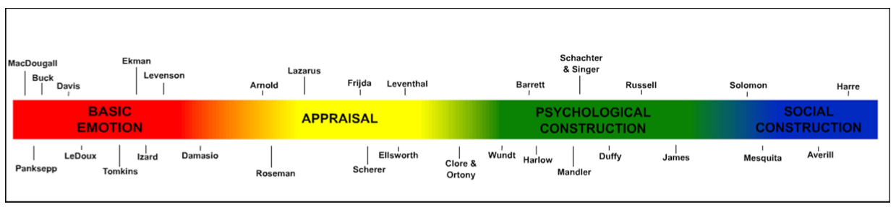
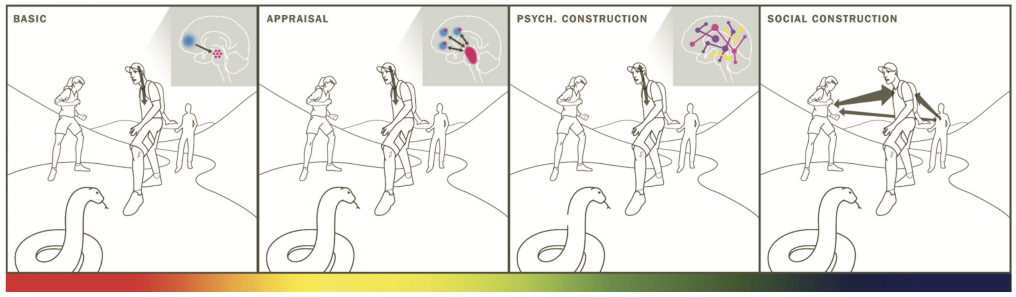
Theories of emotion
CHOONG-WAN WOO | COCOAN lab | http://cocoanlab.github.io
Gross and Barrett, 2011

Slide 13

State-of-the-art emotion movie: “Inside out”
CHOONG-WAN WOO | COCOAN lab | http://cocoanlab.github.io

Slide 14
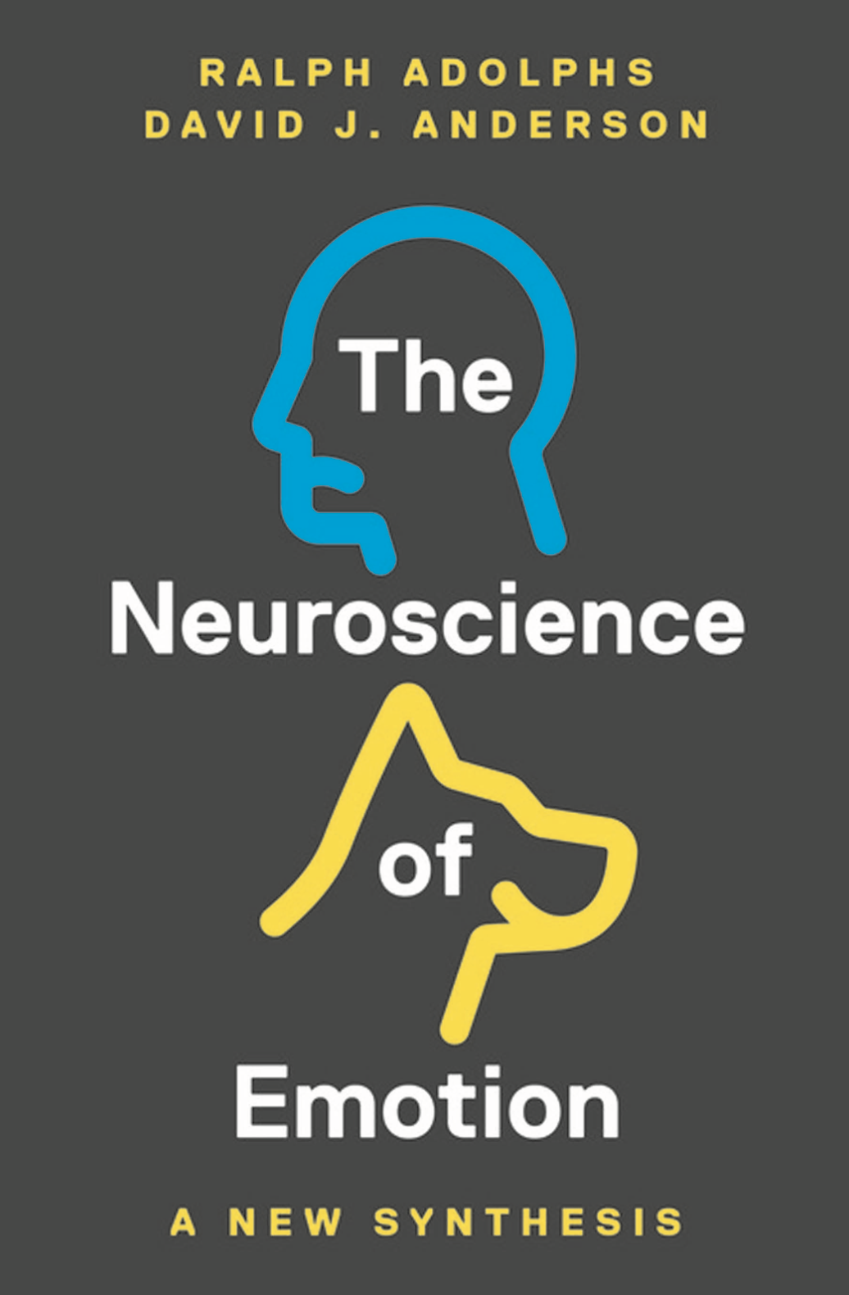
State-of-the-art emotion movie: “Inside out”
Idea 1. There are a few primary emotions? (Paul Ekman, Jaak Panksepp)
Emotions (at least the “primary” ones) are irreducible?
The primary emotions correspond to those for which we have names in English?
Idea 2. Emotions are rigidly triggered by specific external stimuli?
Emotions are like reflexes?
Idea 3. Emotions control our behavior?
Specific emotions cause fixed and specific behaviors?
Idea 4. Different emotions are located in different, discrete brain regions? (e.g., fear in the amygdala)
Specific emotions occur in specific brain structures?
Idea 5. Emotions are conscious homunculi?
Emotions are purely subjective experiences?
CHOONG-WAN WOO | COCOAN lab | http://cocoanlab.github.io

Slide 15
BASIC EMOTION
CHOONG-WAN WOO | COCOAN lab | http://cocoanlab.github.io

Slide 16
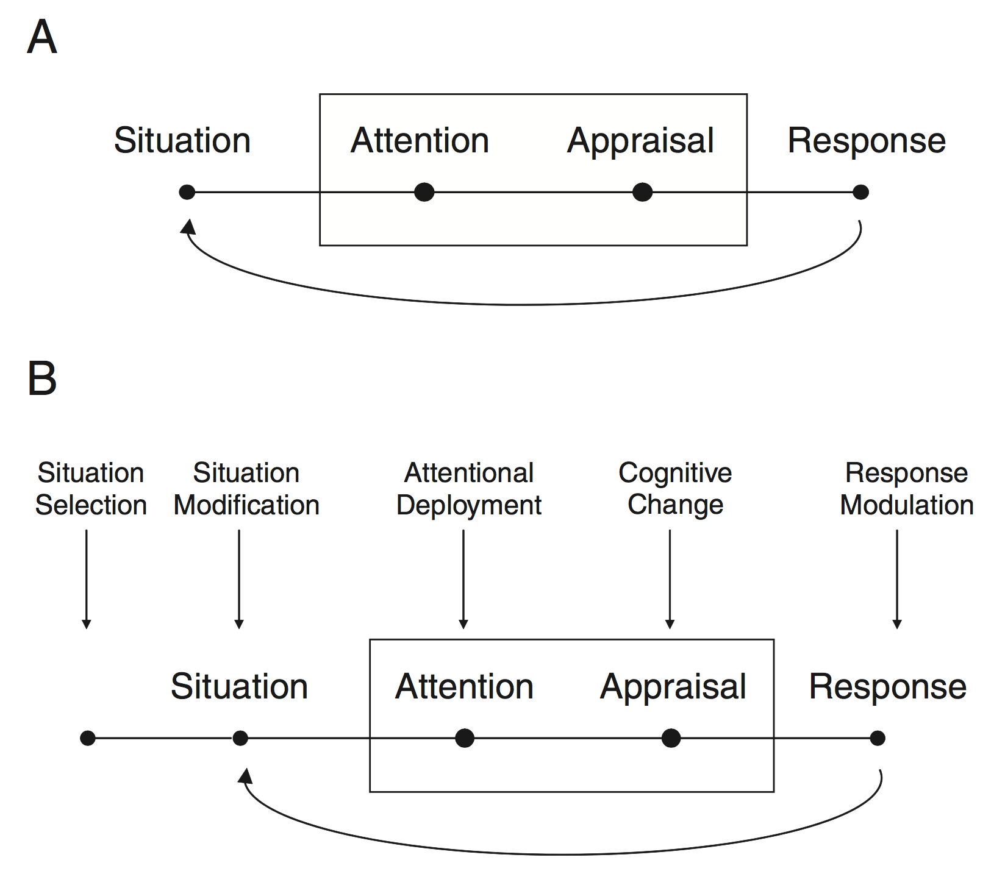
APPRAISAL (1)
James Gross’s emotion generation model
Emotion regulation model
CHOONG-WAN WOO | COCOAN lab | http://cocoanlab.github.io

Slide 17
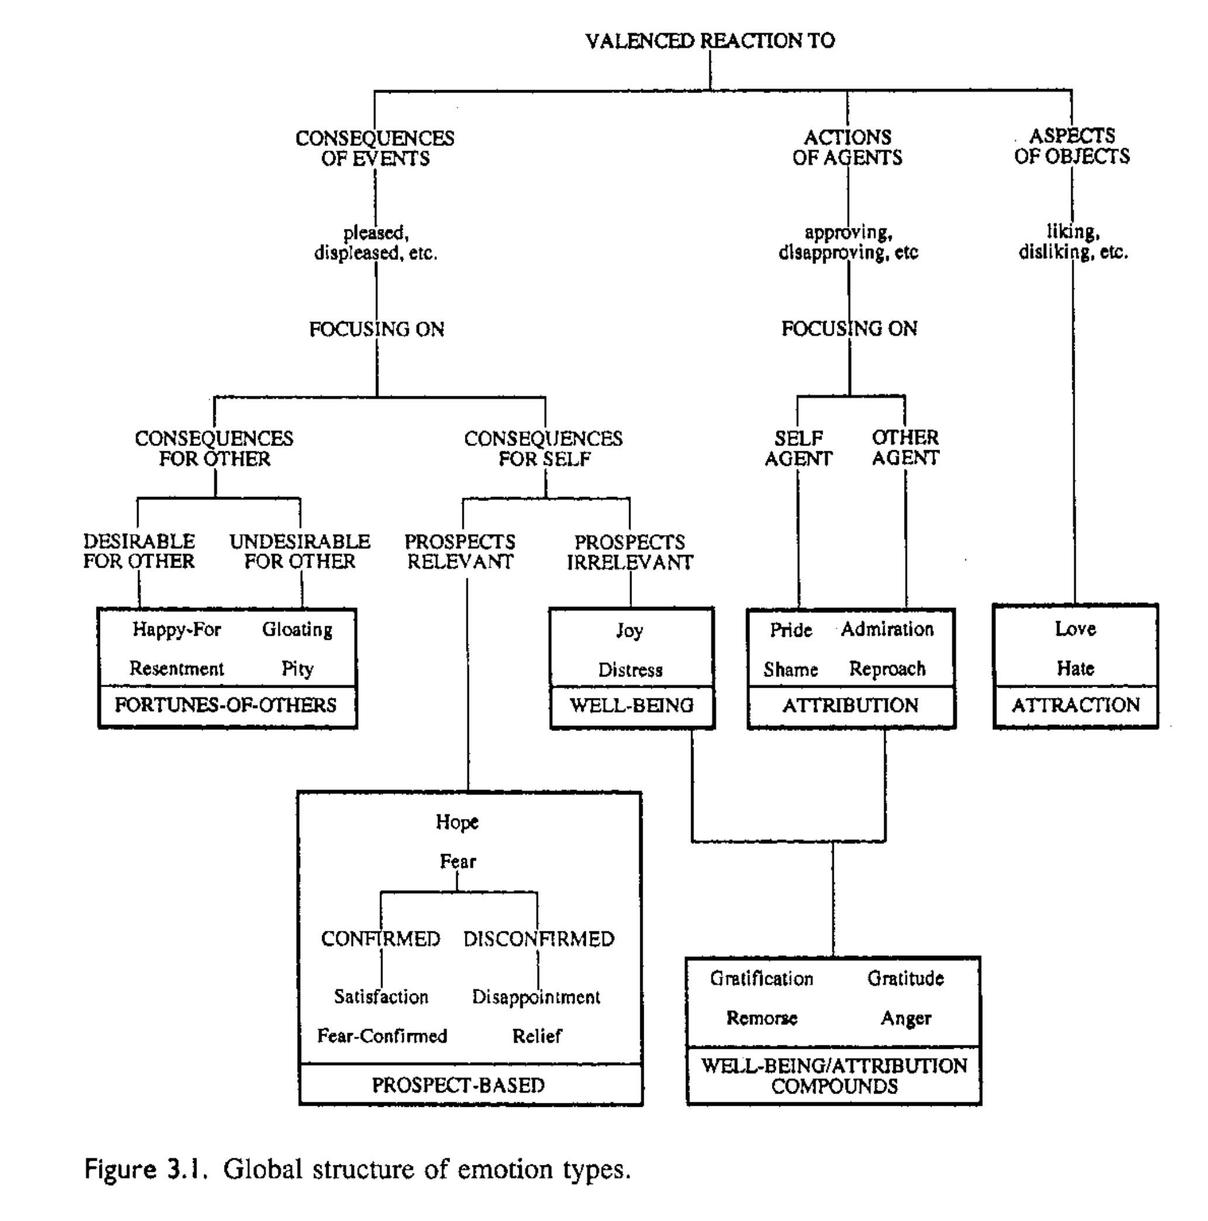
APPRAISAL (2)
CHOONG-WAN WOO | COCOAN lab | http://cocoanlab.github.io
Clore & Ortony, 2000

Slide 18
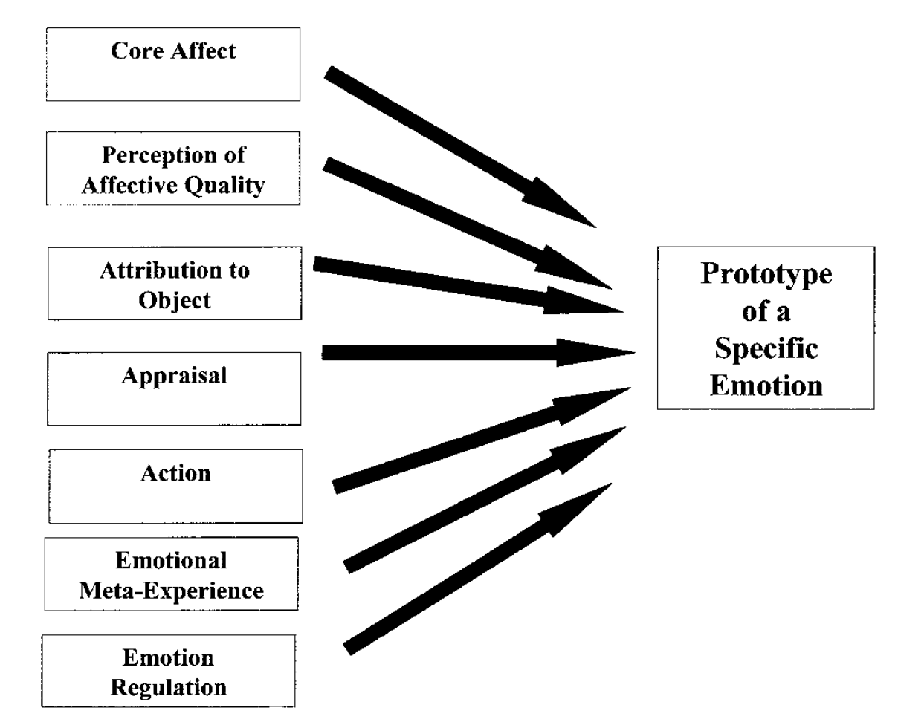
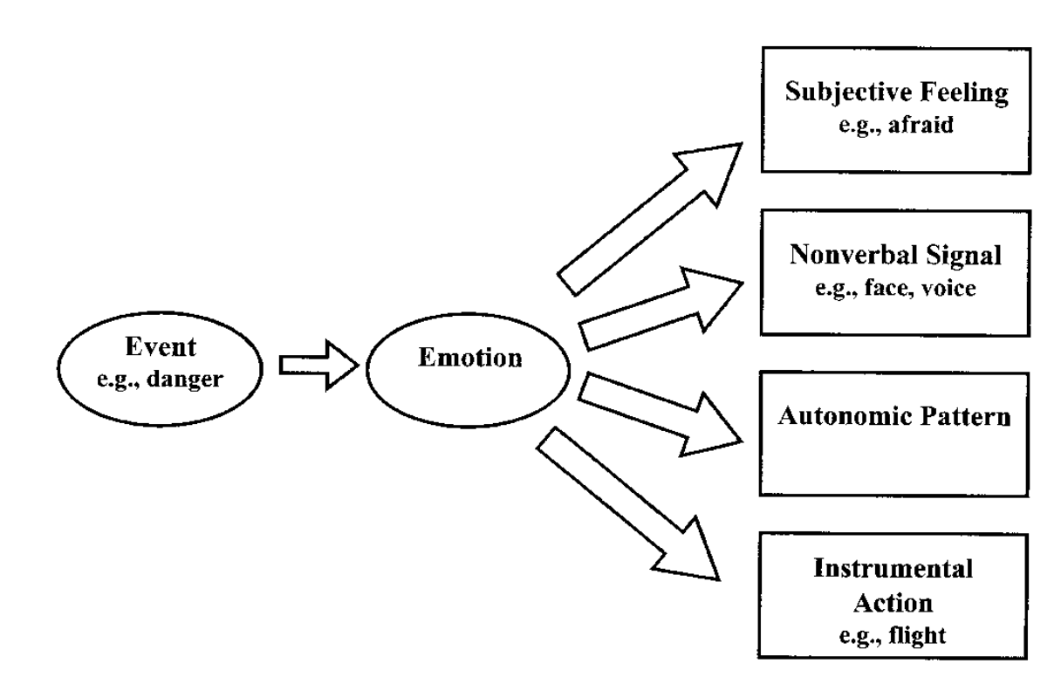
CONSTRUCTION
Alternative view: Emotion as a construct
Traditional view: Emotion as a mediator
CHOONG-WAN WOO | COCOAN lab | http://cocoanlab.github.io

Slide 19
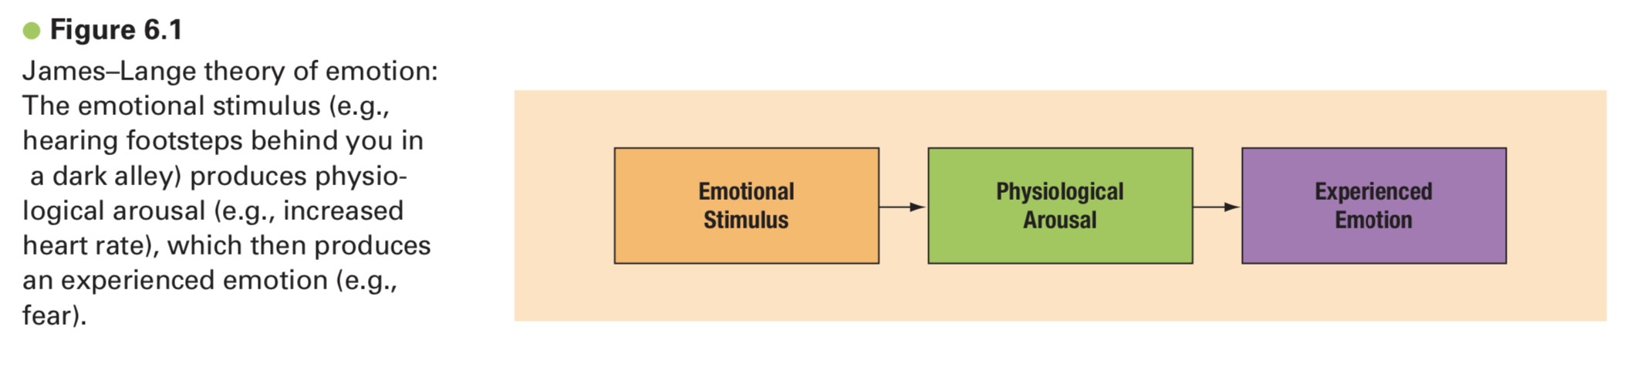
James-Lange theory
CHOONG-WAN WOO | COCOAN lab | http://cocoanlab.github.io

Slide 20
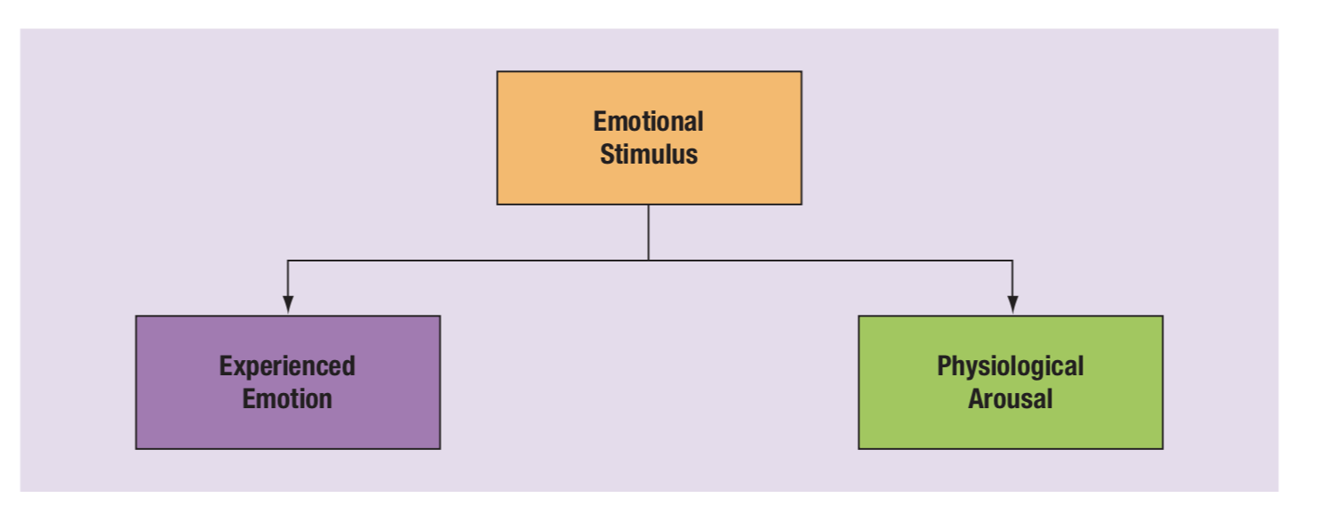
Cannon–Bard theory
CHOONG-WAN WOO | COCOAN lab | http://cocoanlab.github.io

Slide 21
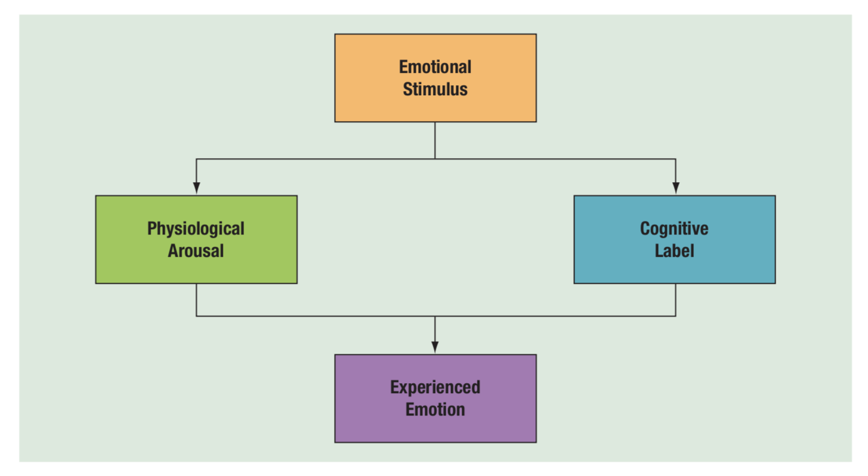
Schachter–Singer theory
Good video for summarizing these textbook theories (James-Lange, Cannon-Bard, Schachter-Singer): https://www.youtube.com/watch?v=gAMbkJk6gnE
CHOONG-WAN WOO | COCOAN lab | http://cocoanlab.github.io

Slide 22
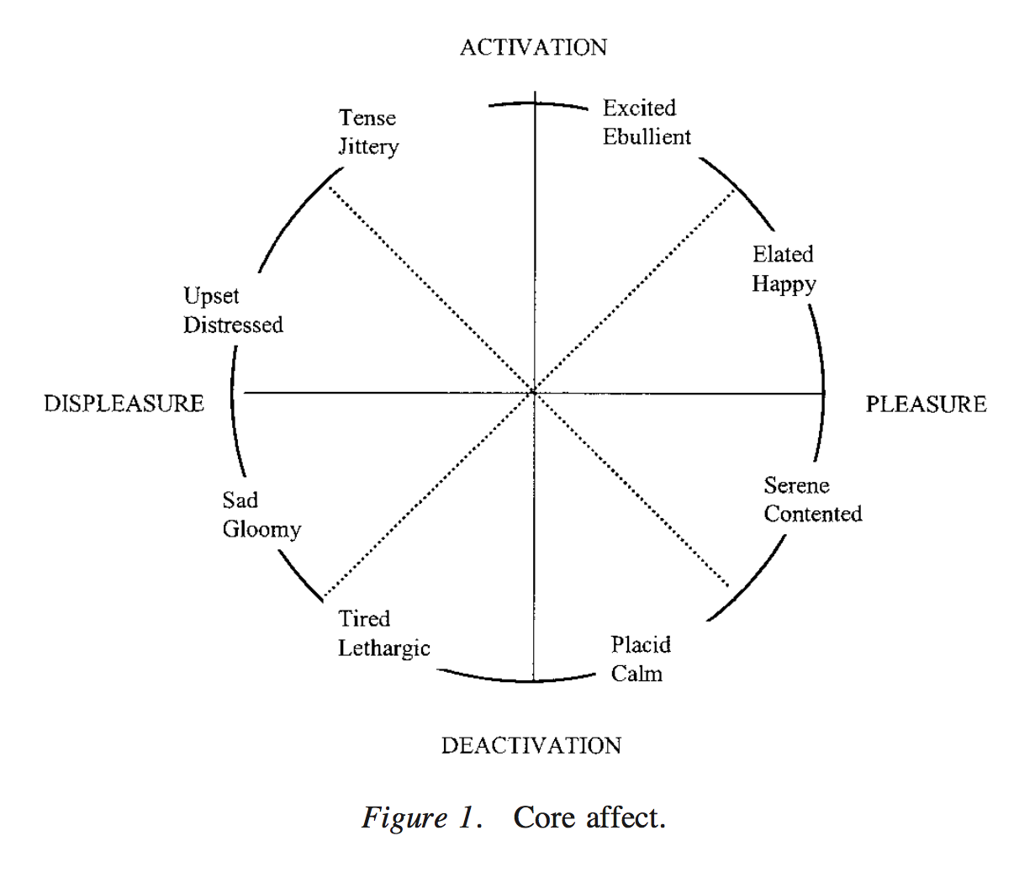
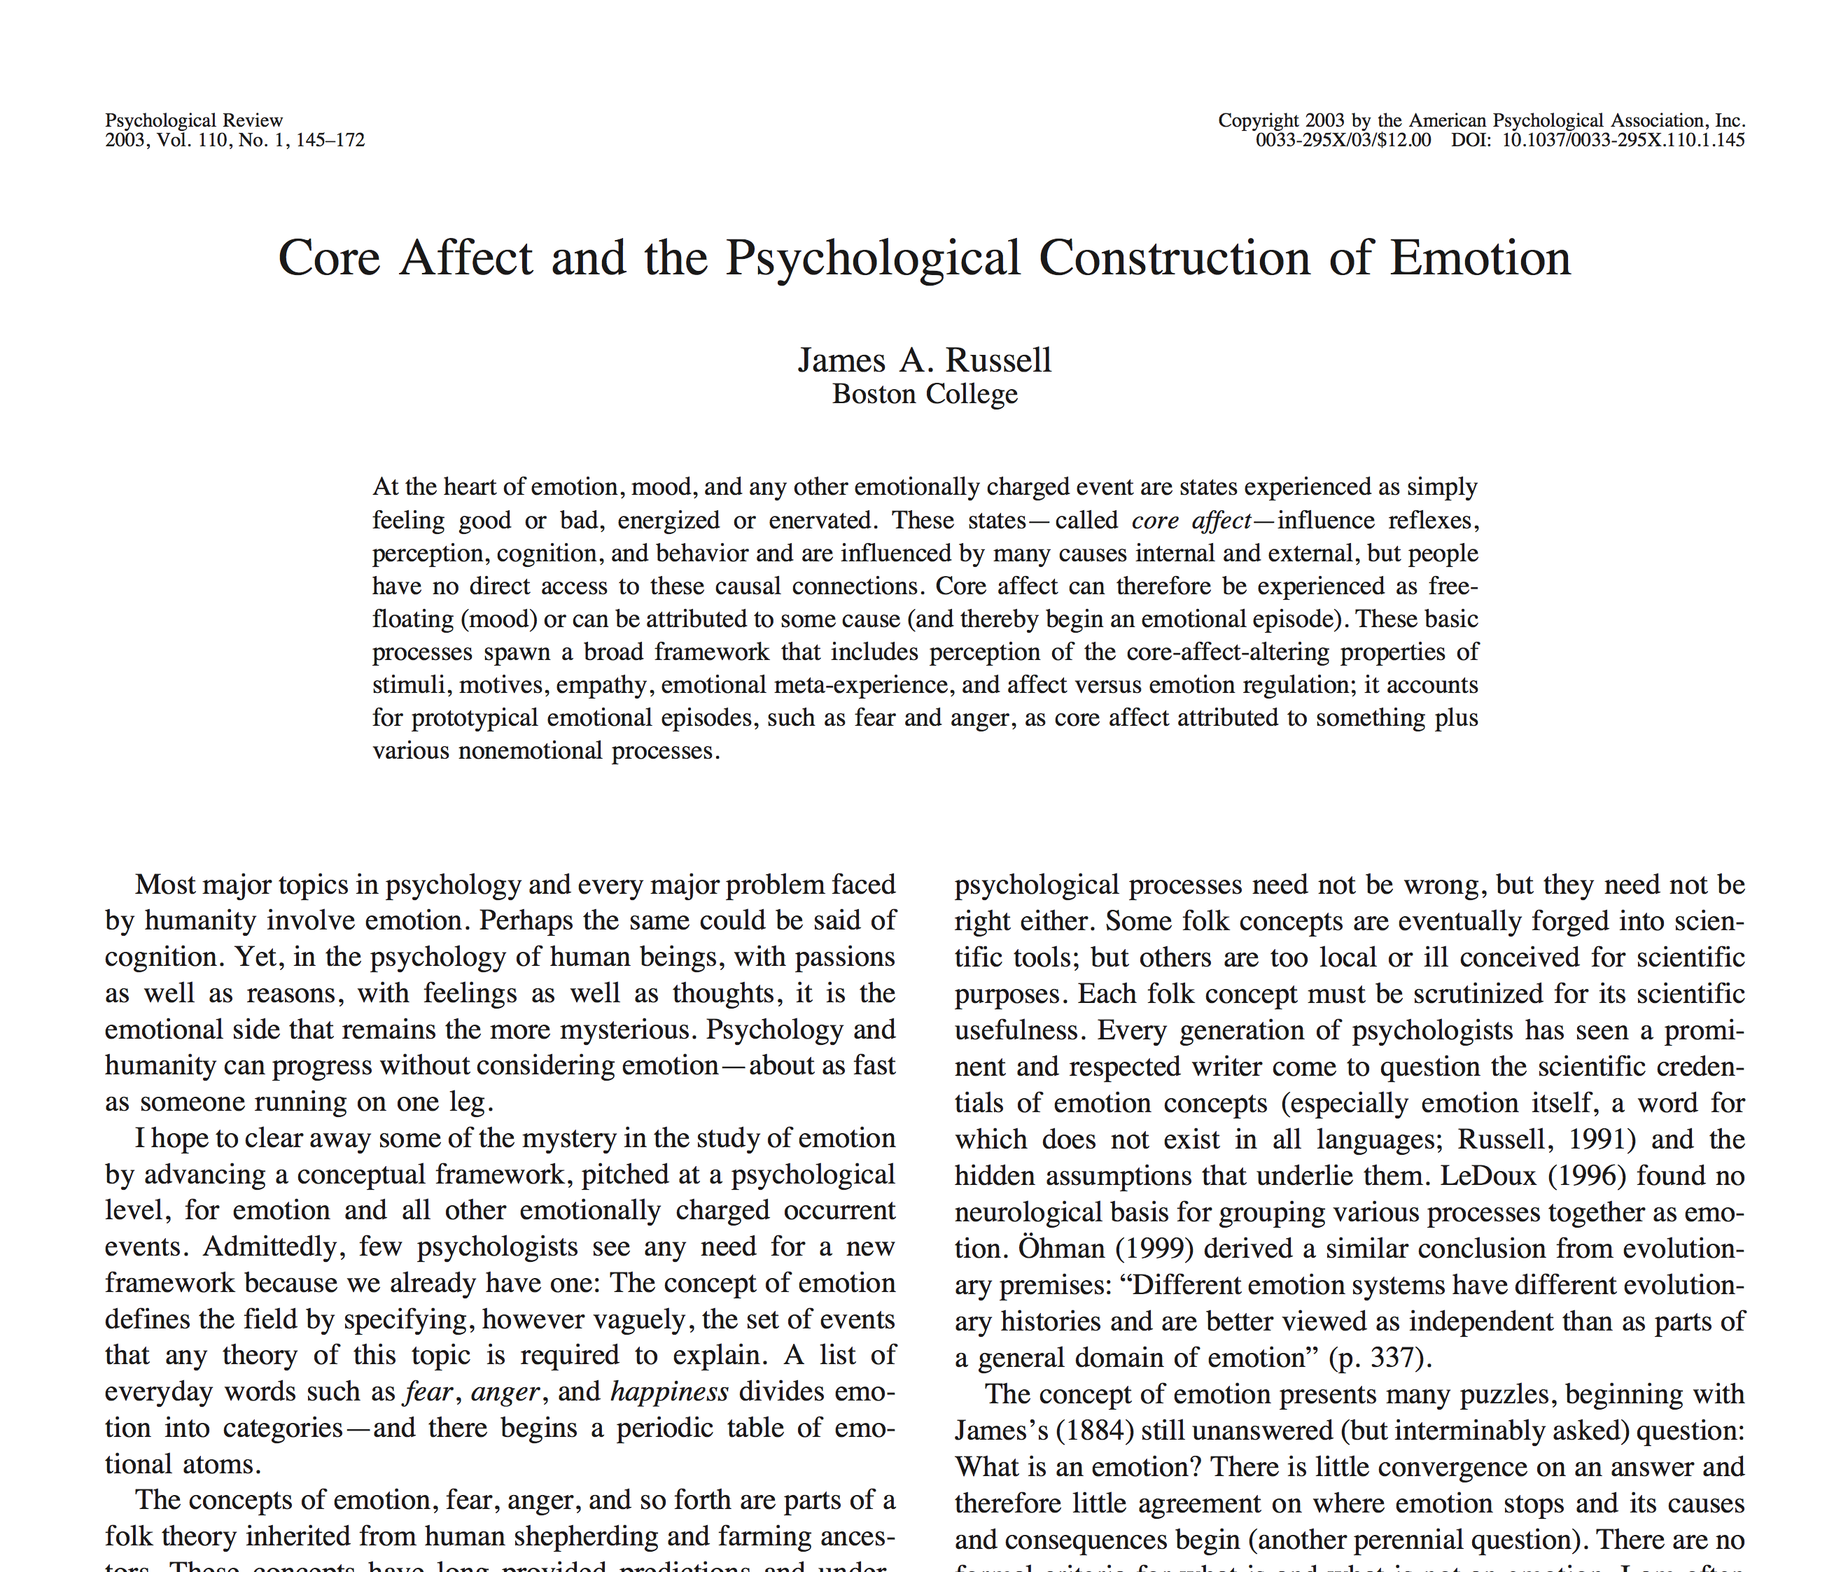
Core affect
Core affect: the “heart of emotion”? (Russell 2003)
neurophysiological state
consciously accessible
integral of hedonic (pleasure–displeasure) and arousal (sleepy–activated) values
object-free (free-floating)
arousal
valence
CHOONG-WAN WOO | COCOAN lab | http://cocoanlab.github.io

Slide 23
Where are you in this spectrum?
CHOONG-WAN WOO | COCOAN lab | http://cocoanlab.github.io
Gross and Barrett, 2011

Slide 24
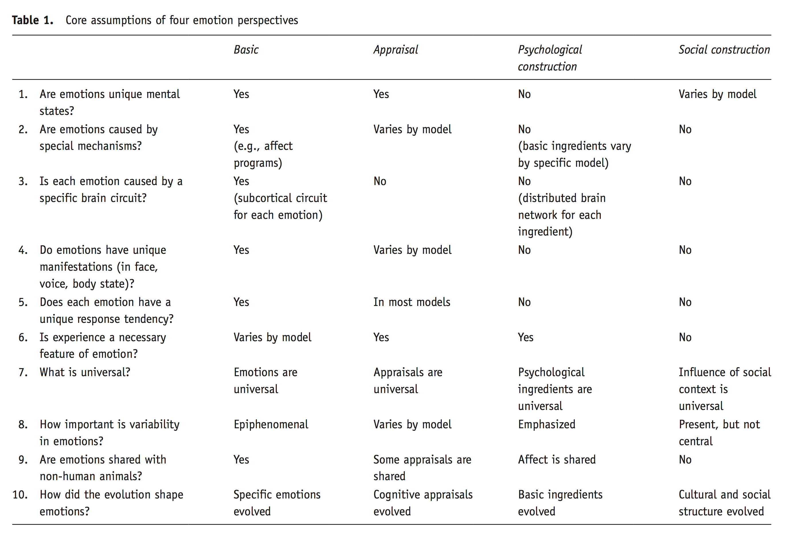
Gross and Barrett, 2011

Slide 25
Where am I?
Choong-Wan Woo
CHOONG-WAN WOO | COCOAN lab | http://cocoanlab.github.io
Gross and Barrett, 2011

Slide 26
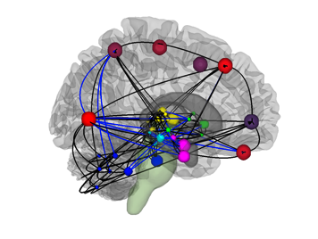

Emotion: Coordinated brain responses
“Emotions” are multi-system responses to highly relevant events we encounter
“Emotions” are labels for consistent patterns of well-coordinated brain processes
attention
action
prospection
perception
memory
metabolism
Barrett, L.F. et al. 2006, 2009, 2013; Lindquist et al. 2011, 2012; J. Price, 1999; Bandler, 2000
CHOONG-WAN WOO | COCOAN lab | http://cocoanlab.github.io

Slide 27
Self and valence
CHOONG-WAN WOO | COCOAN lab | http://cocoanlab.github.io

Slide 28
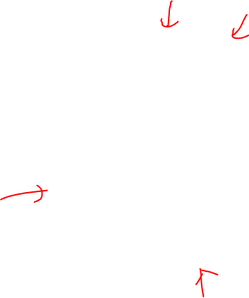
Is this the end of story?
CHOONG-WAN WOO | COCOAN lab | http://cocoanlab.github.io

Slide 29
Dimensionality Reduction in Affective Neuroscience
Which dimensions are important for survival (or living)?
CHOONG-WAN WOO | COCOAN lab | http://cocoanlab.github.io

Slide 30

Self & Valence
To achieve:
Survival
Self-preservation
Well-being
Etc.
Good
Key dimensions
for any living organisms
Me
Valence
Not me
Self
Bad
CHOONG-WAN WOO | COCOAN lab | http://cocoanlab.github.io

Slide 31
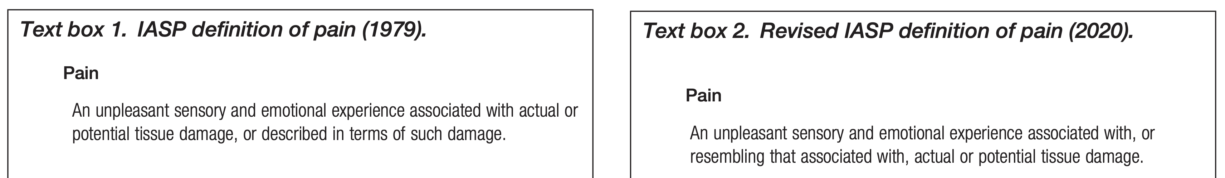
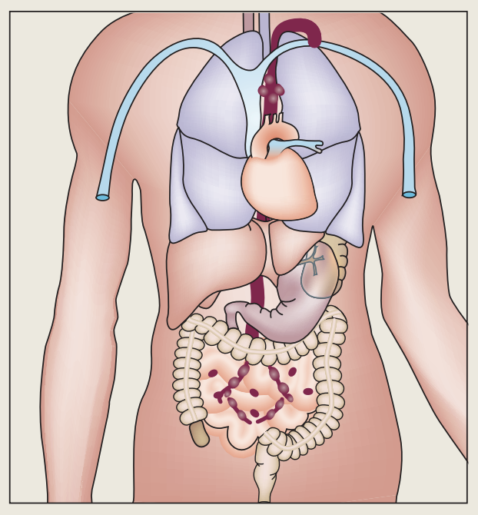
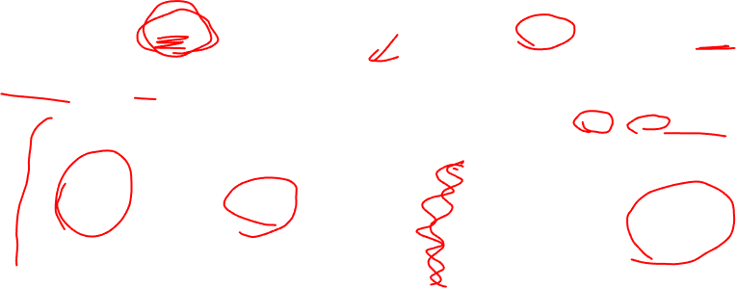
What is the most important component of “me”?
Good
Key dimensions
for any living organisms
Me
Valence
Not me
Self
The most important “Me” is the body; esp. the interior part of the body
Interoception = sensing the interior part of the body
= the key feature of the affect (good vs. bad)
Bad
CHOONG-WAN WOO | COCOAN lab | http://cocoanlab.github.io

Slide 32
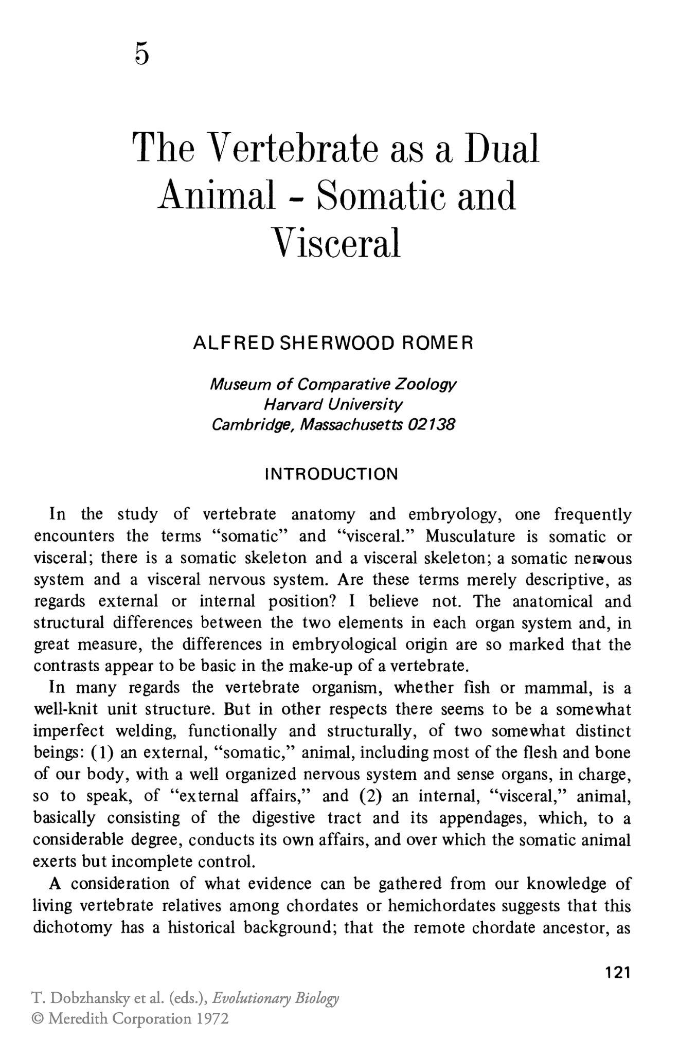
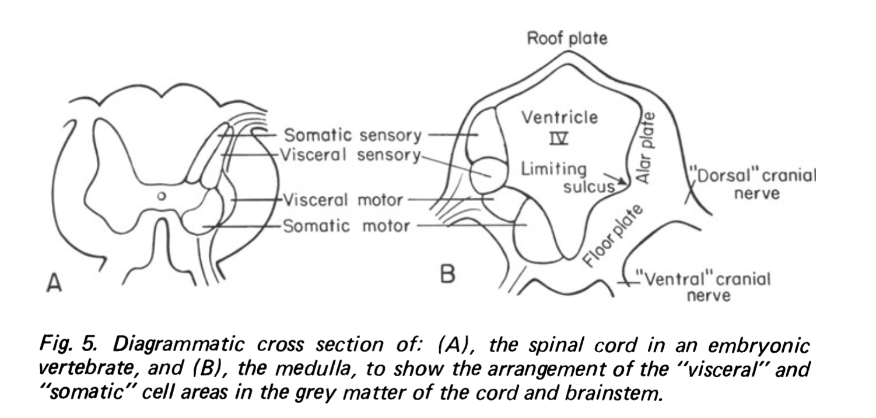

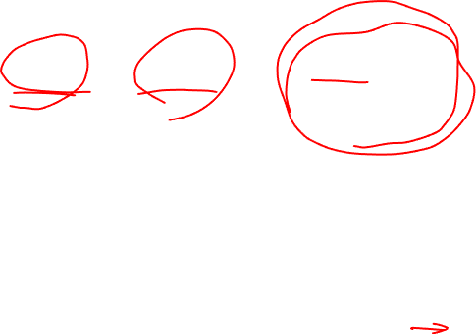
Dual system for somatic vs visceral
CHOONG-WAN WOO | COCOAN lab | http://cocoanlab.github.io

Slide 33
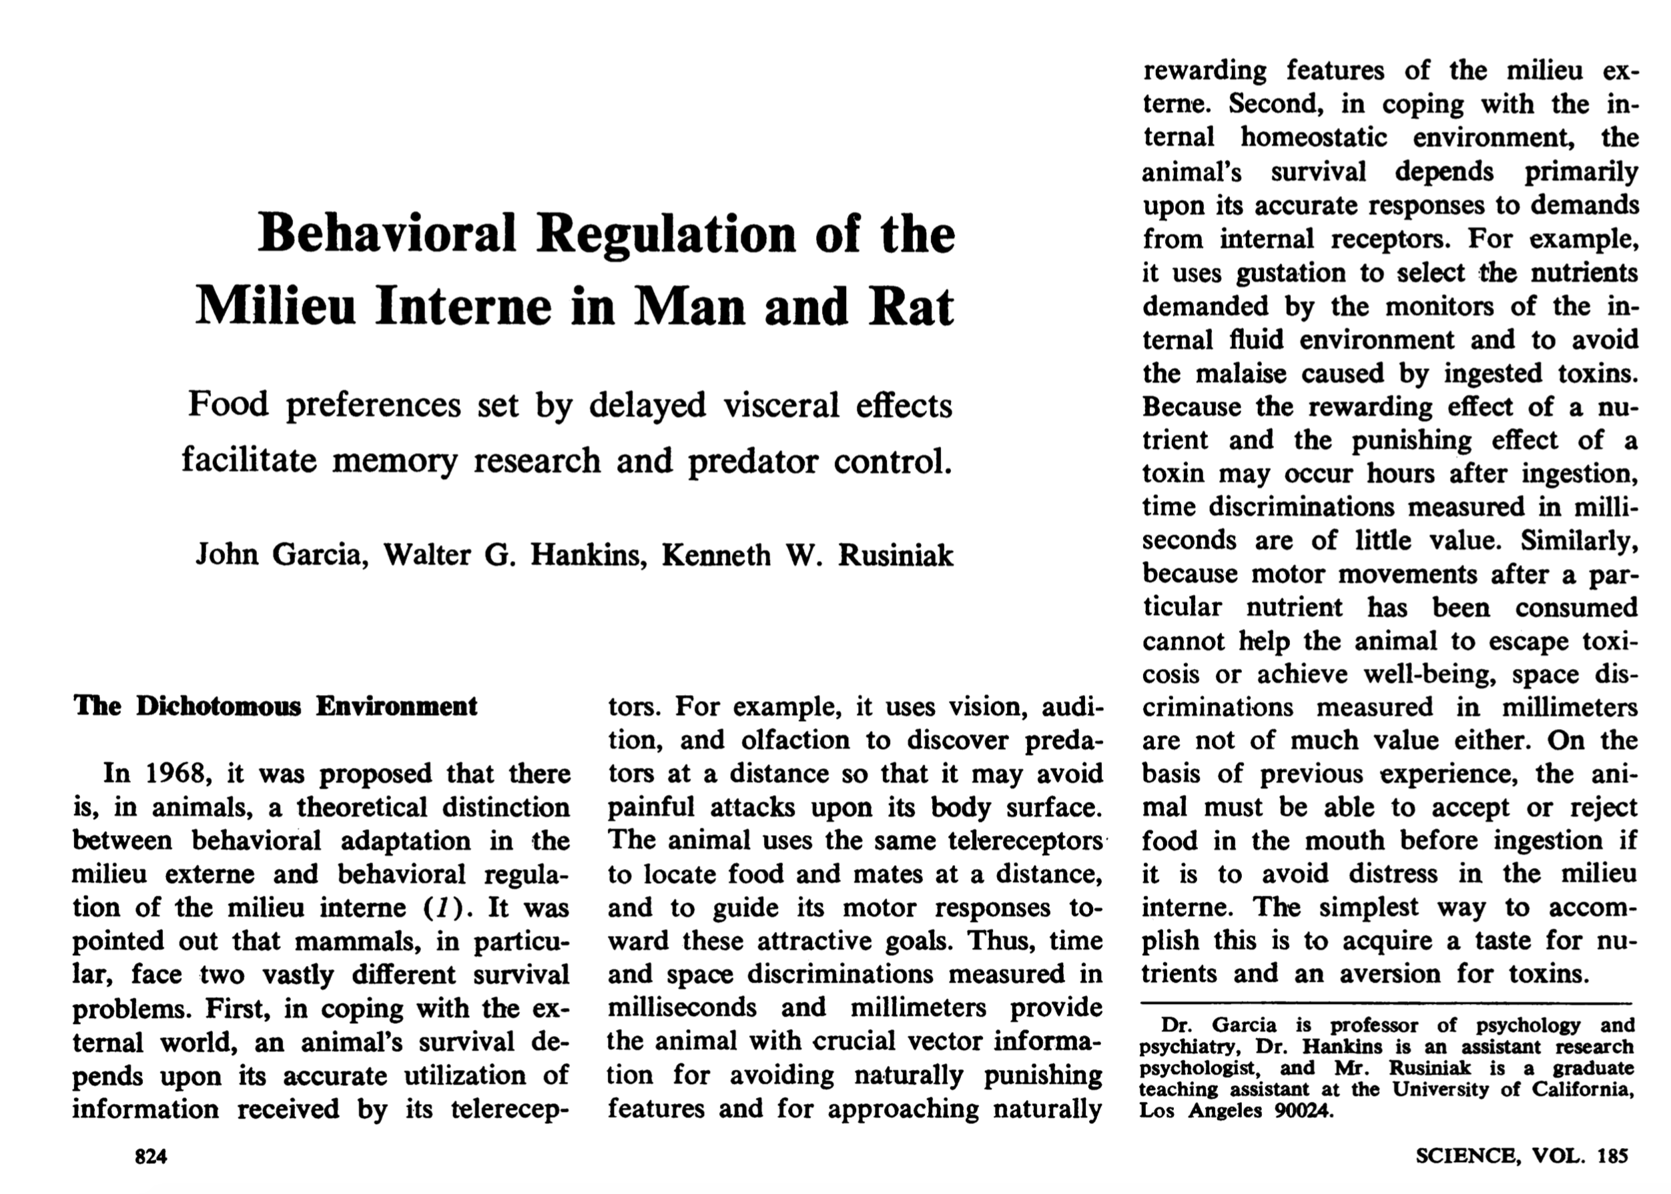
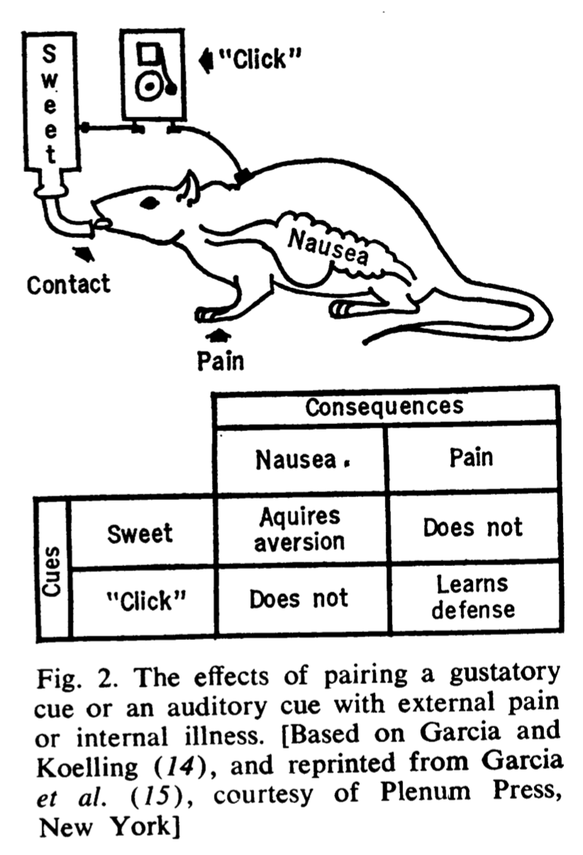
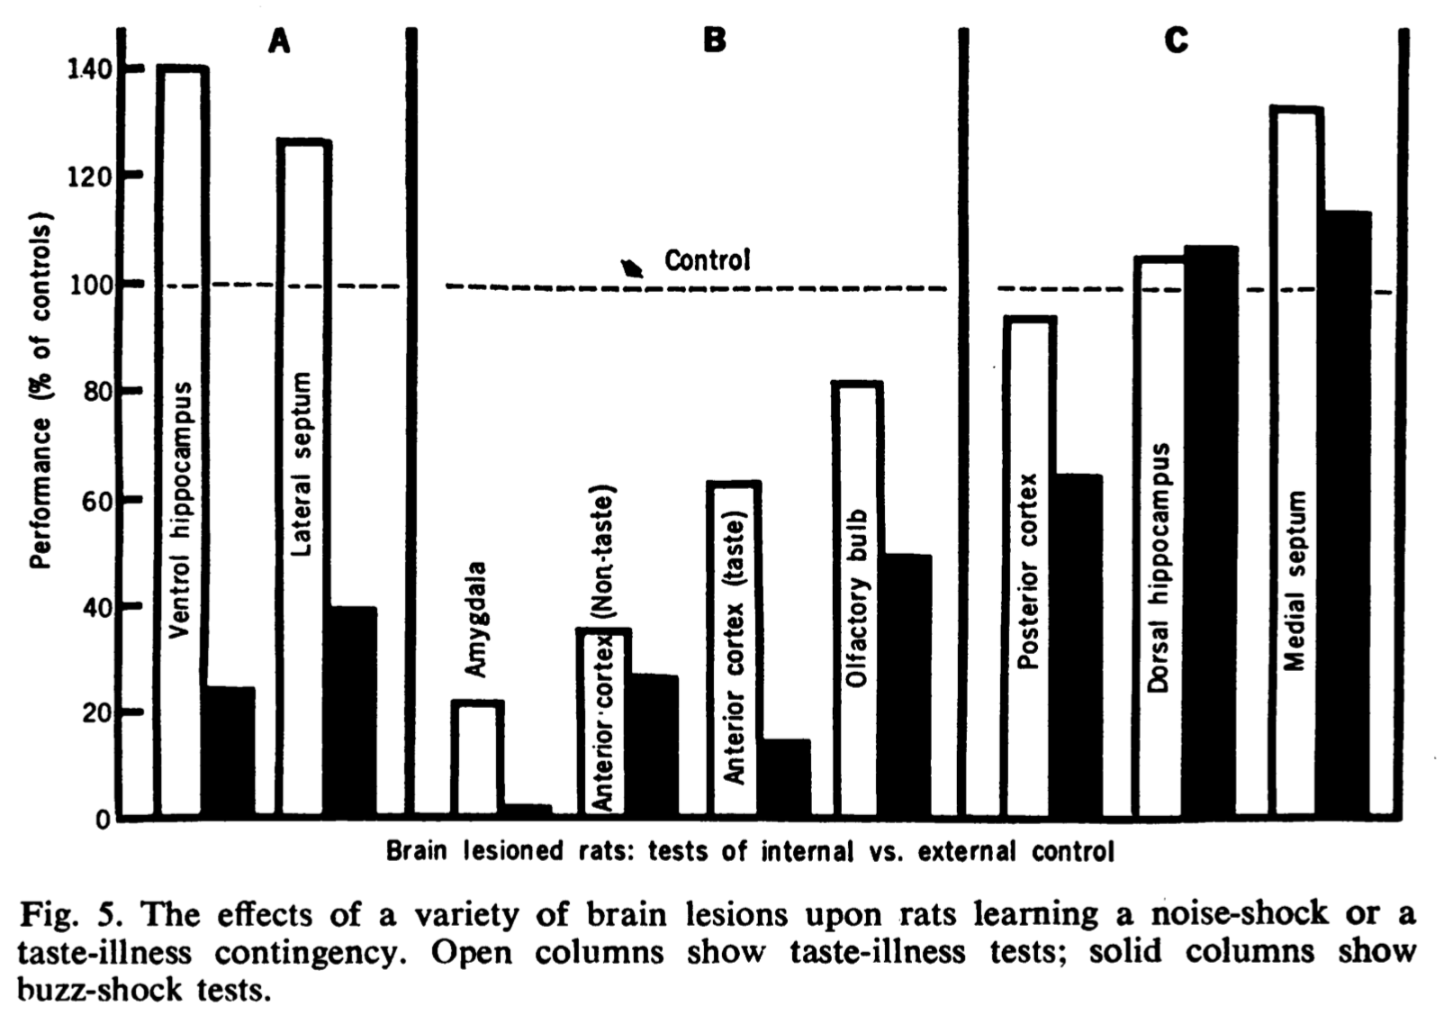
Neural systems for regulating internal milieu are distinct from systems for external environment
Taste-illness test (interior)
Buzz-shock test (exterior)
Controlling internal milieu is well-preserved (it’s more basic)
CHOONG-WAN WOO | COCOAN lab | http://cocoanlab.github.io

Slide 34
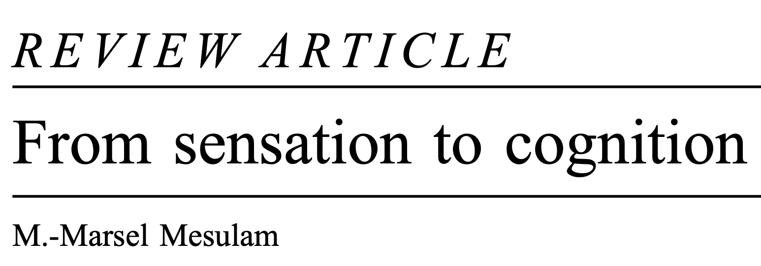
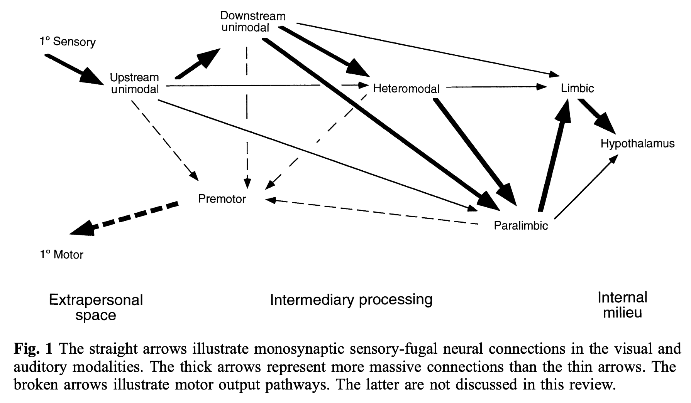
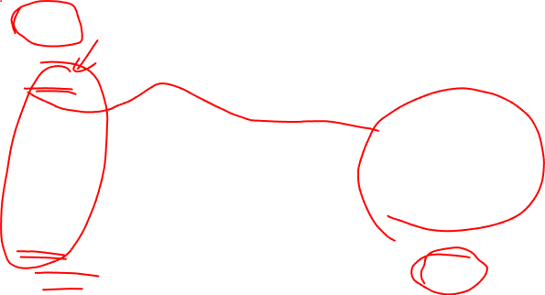
Not me
Me
Mesulam, 1998, Brain
CHOONG-WAN WOO | COCOAN lab | http://cocoanlab.github.io

Slide 35
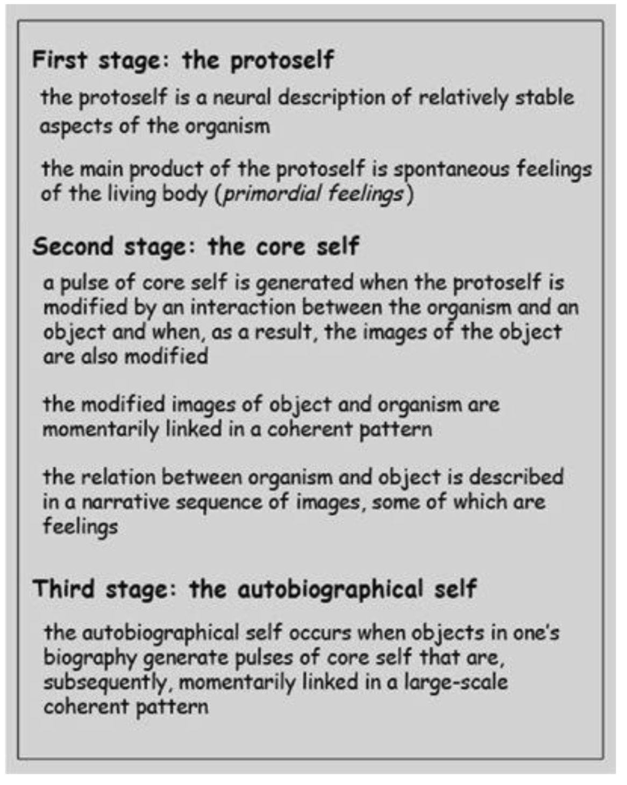
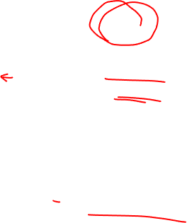
But for human, there are more than the body!
CHOONG-WAN WOO | COCOAN lab | http://cocoanlab.github.io

Slide 36
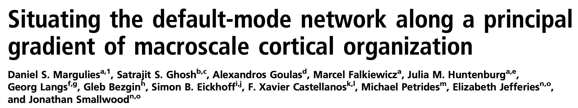
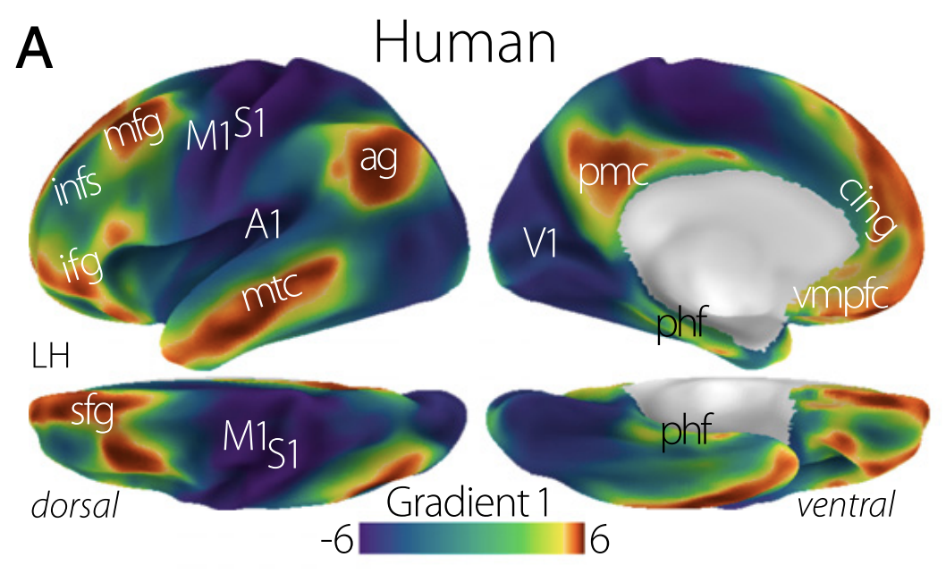
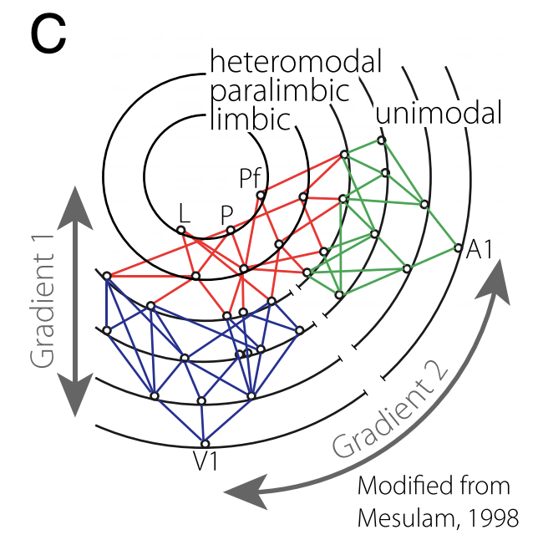
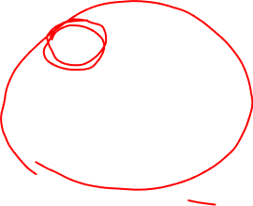
Me
Not me
Not me
Me
Margulies et al., 2016, PNAS
CHOONG-WAN WOO | COCOAN lab | http://cocoanlab.github.io

Slide 37
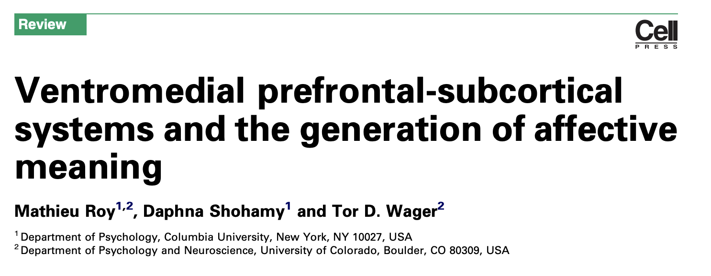
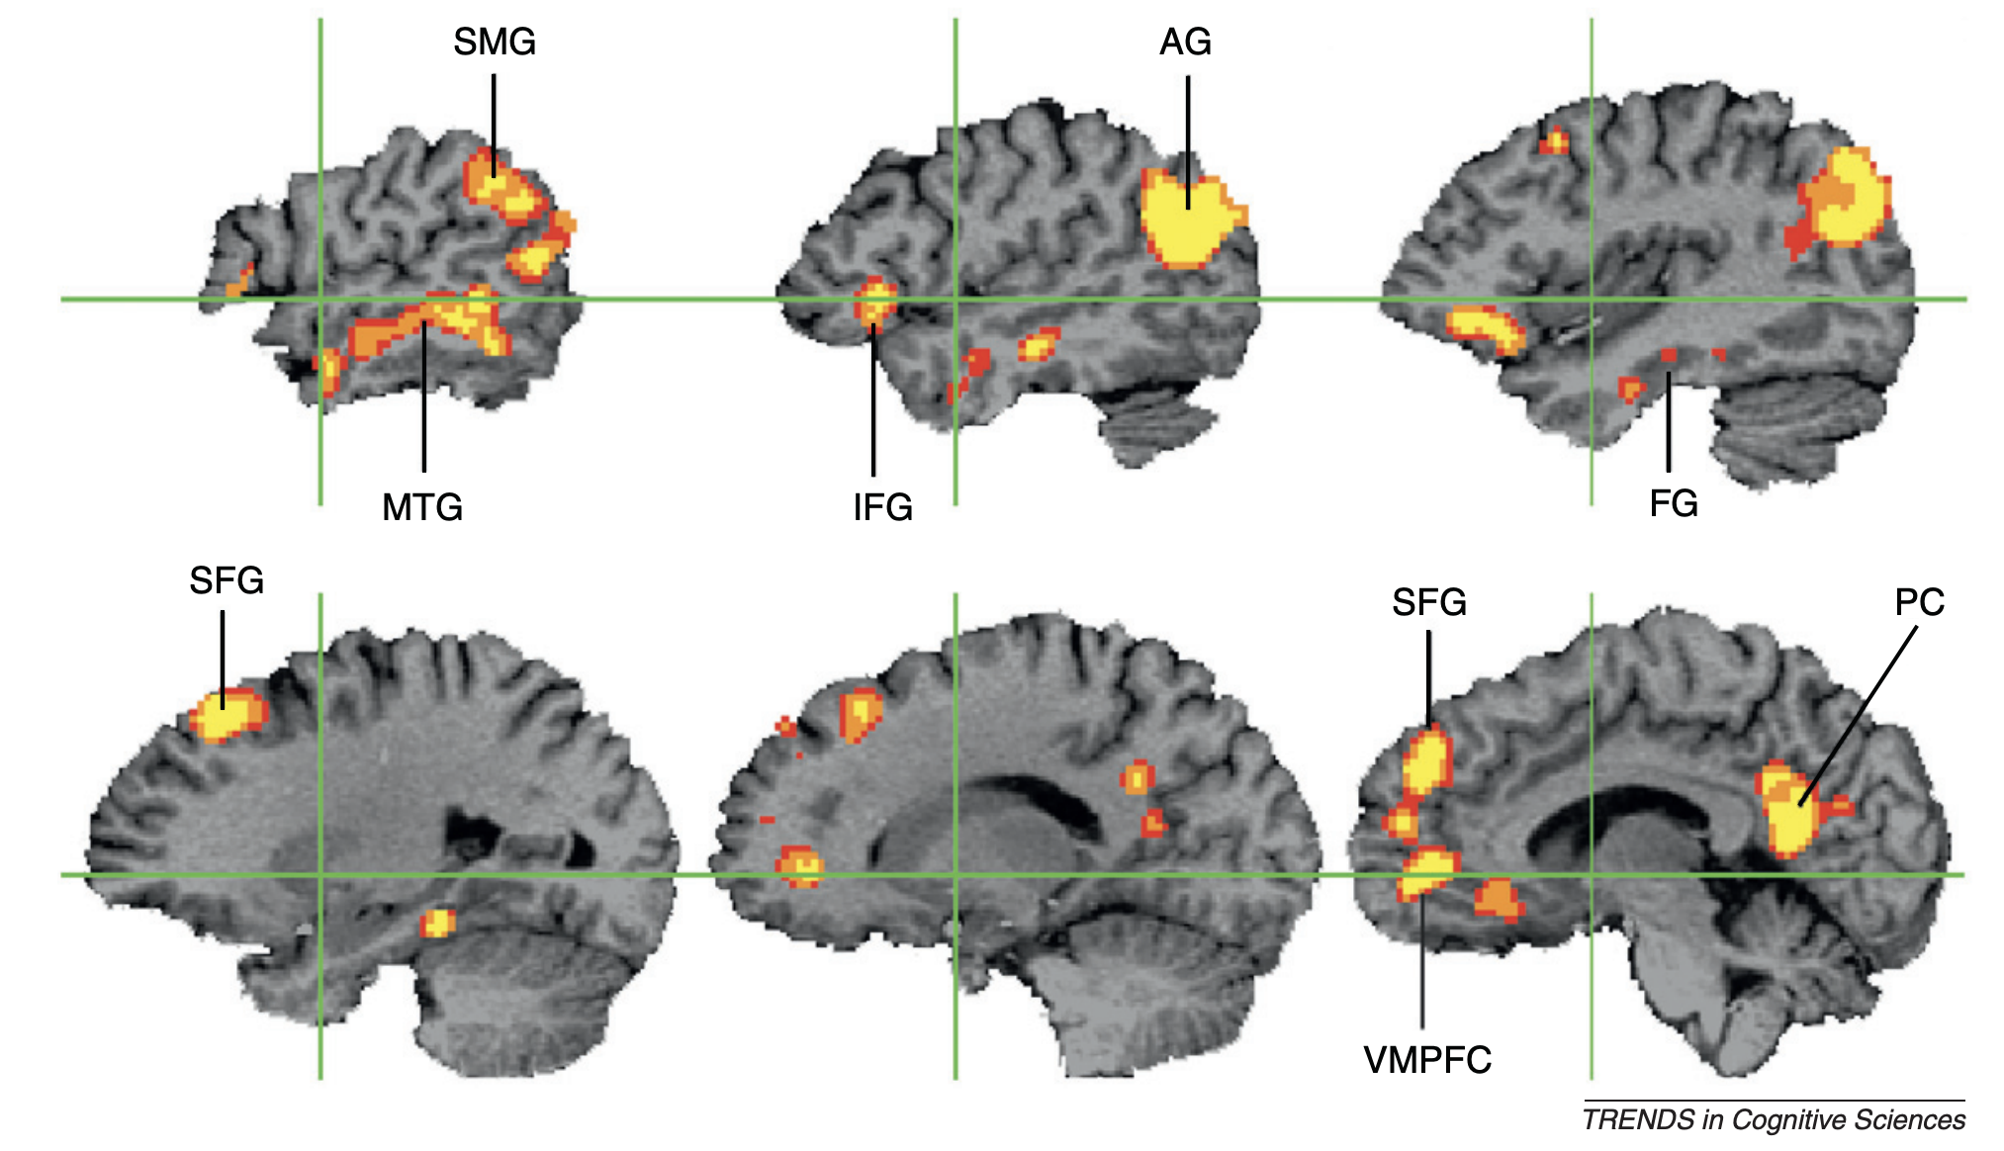

Overlap between “me” system and “meaning” system in the brain
Not me
Me
Meta-analysis of semantic processing
Margulies et al., 2016, PNAS; Binder & Desai, 2011, TICS
CHOONG-WAN WOO | COCOAN lab | http://cocoanlab.github.io

Slide 38
Brain in affective neuroscience
CHOONG-WAN WOO | COCOAN lab | http://cocoanlab.github.io

Slide 39
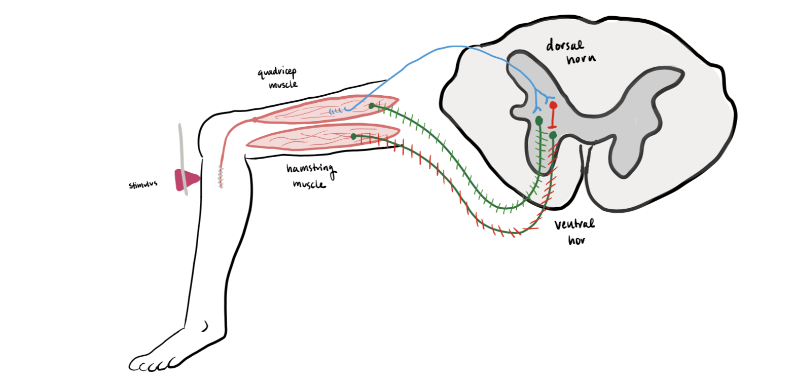

Emotion: mere reflexes?
Something like knee jerk reflex?
CHOONG-WAN WOO | COCOAN lab | http://cocoanlab.github.io

Slide 40
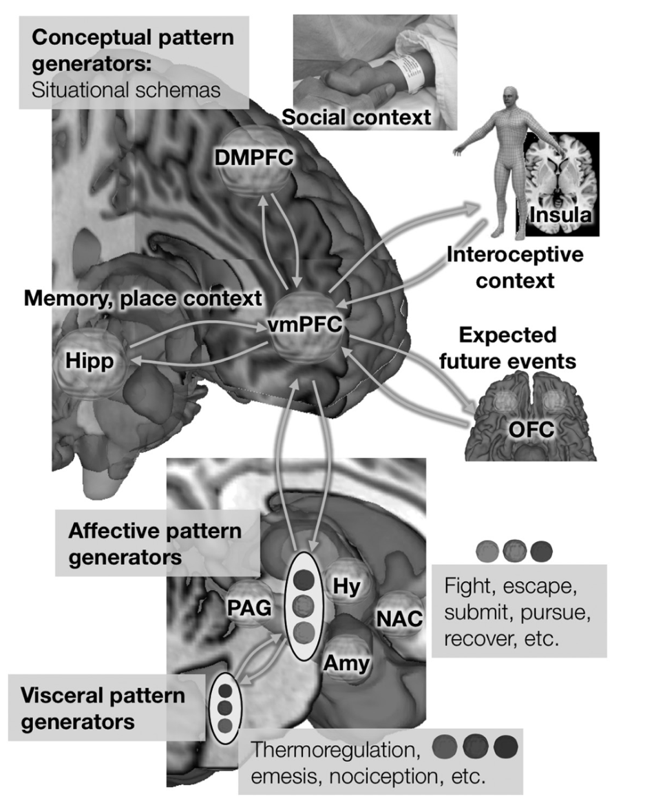
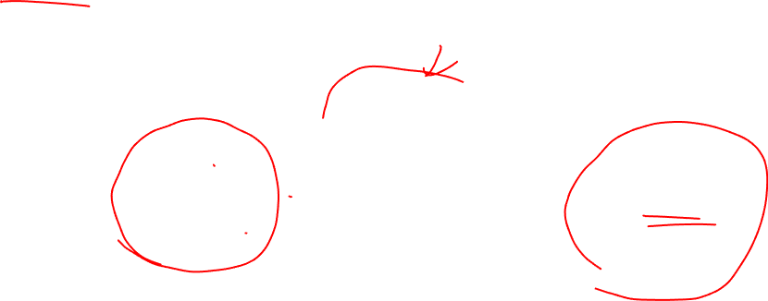
Emotion: decoupled reflexes
Stimulus
Response
CHOONG-WAN WOO | COCOAN lab | http://cocoanlab.github.io

Slide 41
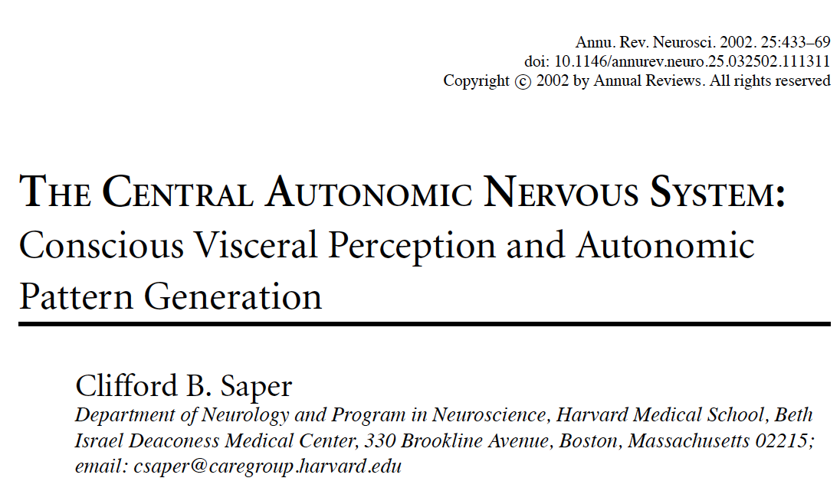
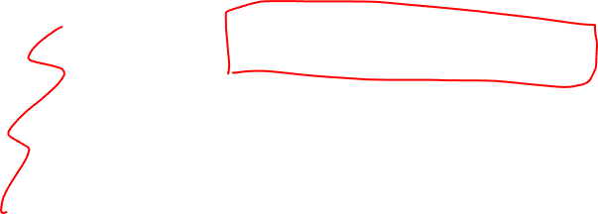
CNS control of ANS: Visceromotor network
CHOONG-WAN WOO | COCOAN lab | http://cocoanlab.github.io

Slide 42
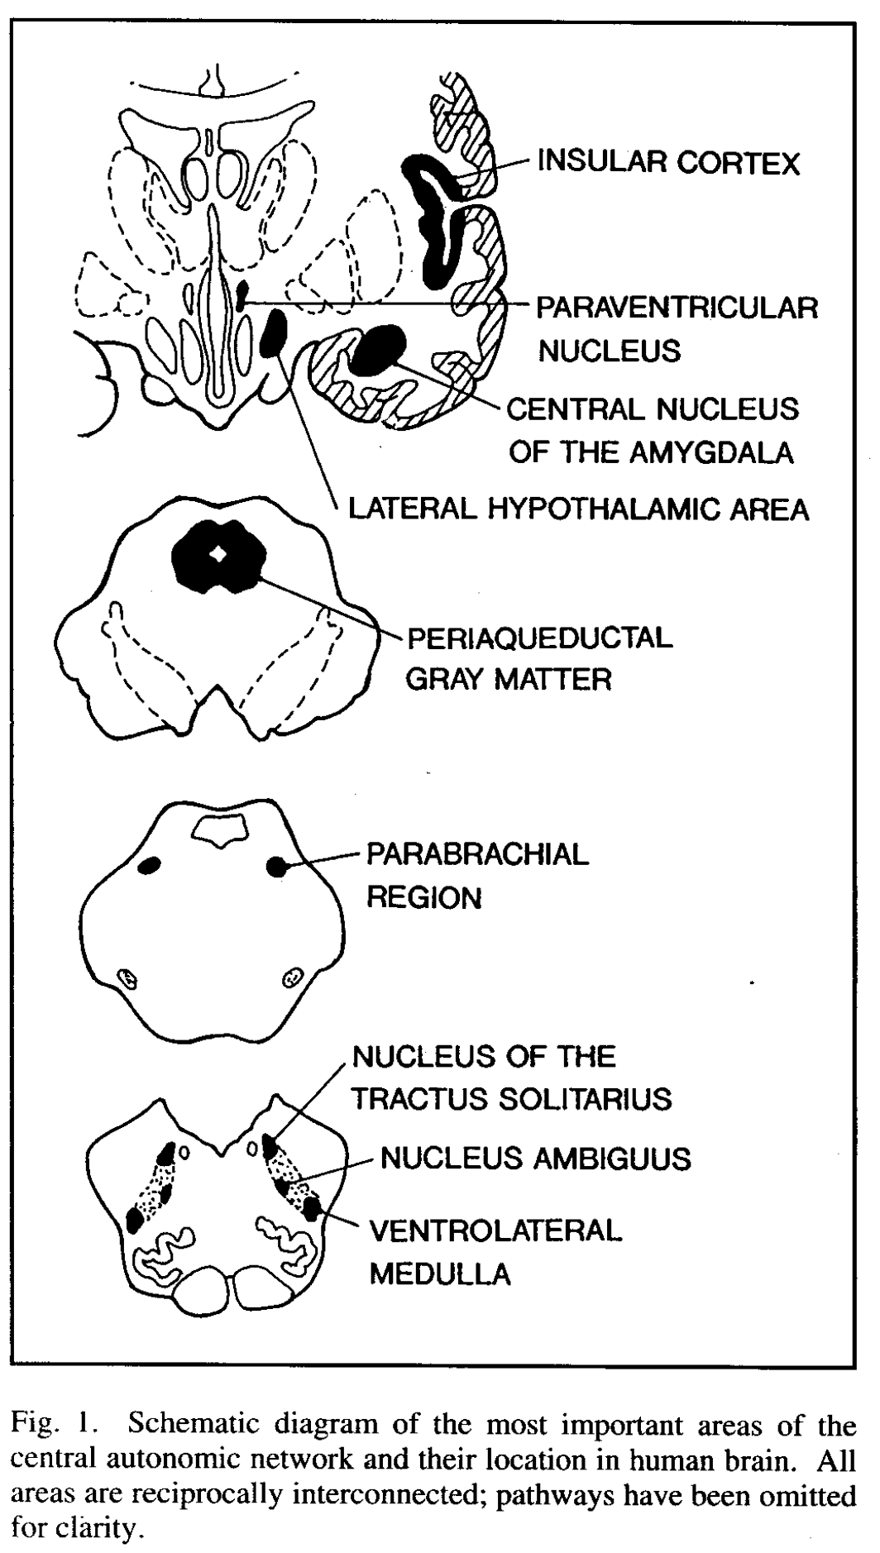
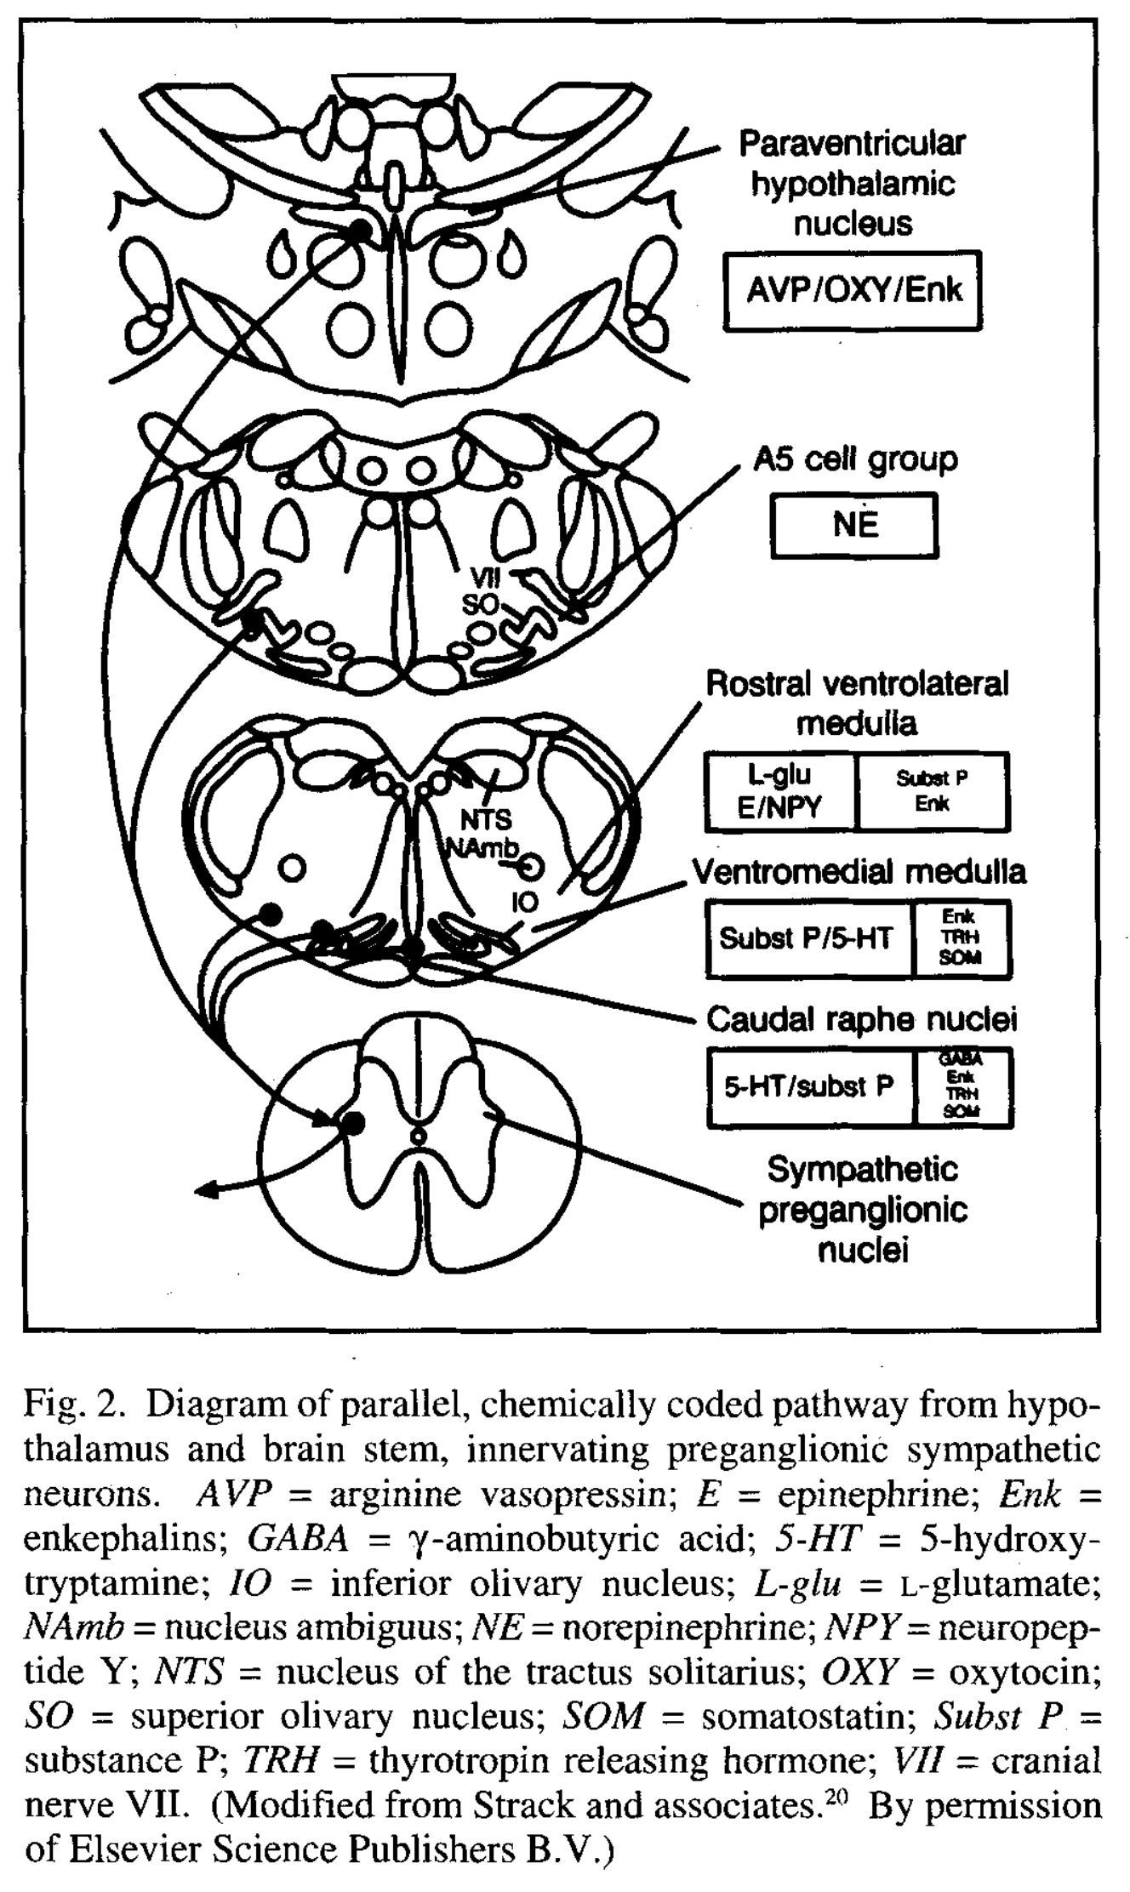
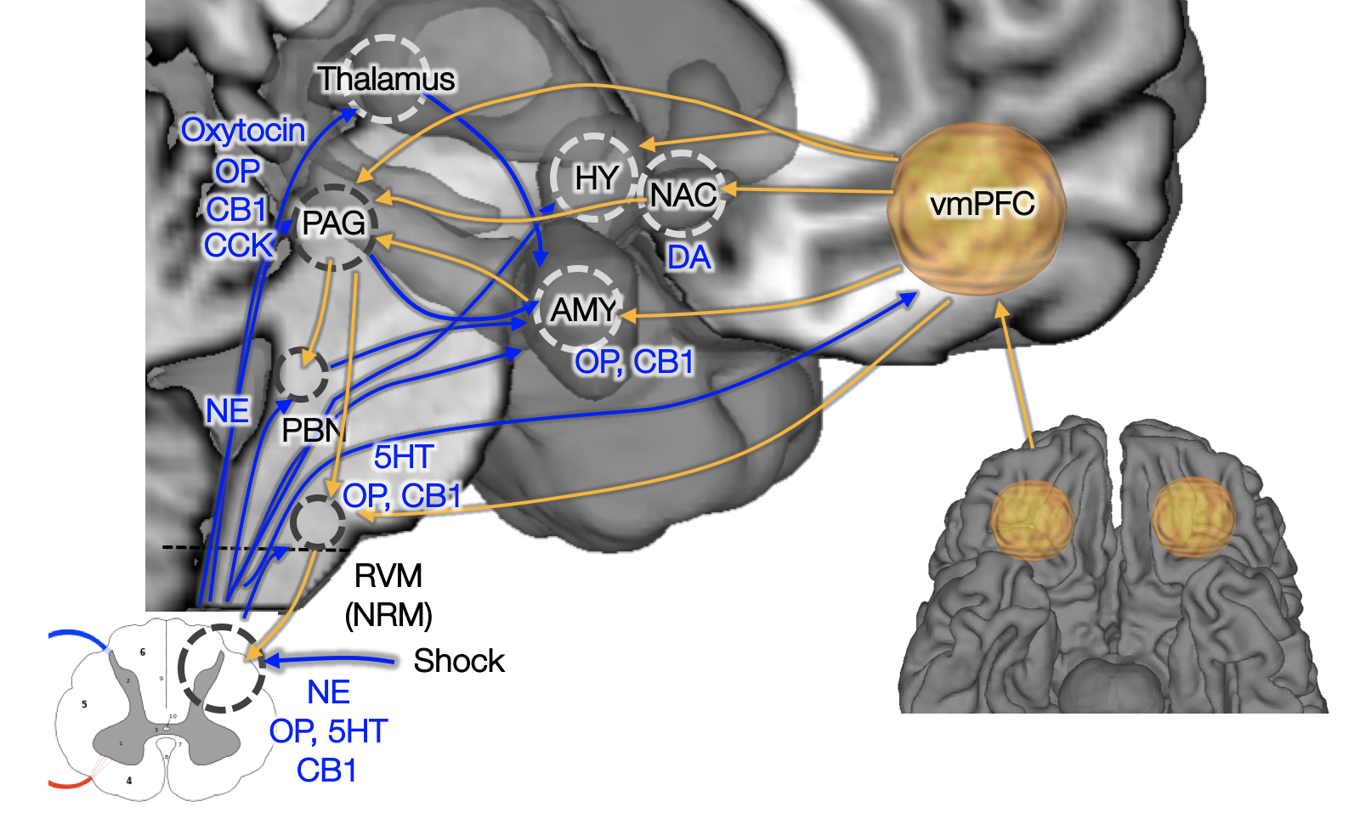

CNS control of ANS: Visceromotor network
Descending projections from multiple systems
Critical areas: Hypothalamus, PAG, amygdala, and medial prefrontal cortex, etc.
Called the “visceromotor” network or “central autonomic network”
CHOONG-WAN WOO | COCOAN lab | http://cocoanlab.github.io

Slide 43


CNS control of ANS: Visceromotor network
Medical cortical
visceromotor
system
Central opioid and 5HT system
Central NE system
Cranial nerve nuclei and others
Sympathetic output
Parasympathetic output
Wager (2015), Benarroch (1993)

Slide 44









Emotion as visceral-affective-conceptual pattern generation process!
Conceptual pattern generators:
Situational schemas
Social context
DMPFC
Insula
Interoceptive
context
Memory, place context
vmPFC
Expected future events
Hipp
OFC
Affective pattern generators
Hy
Fight, escape, submit, pursue, recover, etc.
PAG
NAC
Amy
Wager & Atlas, 2015, Nature Reviews Neuroscience
Visceral pattern generators
Thermoregulation, emesis, nociception, etc.
CHOONG-WAN WOO | COCOAN lab | http://cocoanlab.github.io

Slide 45

“Where am I” determines the lab’s research direction
Choong-Wan Woo
Gross and Barrett, 2011
CHOONG-WAN WOO | COCOAN lab | http://cocoanlab.github.io

Slide 46
Our lab’s research direction
Emotions are more malleable than you think!
Against dualism (1): Emotion generation vs. regulation??
Against dualism (2): Cognition vs. Emotion?
Against dualism (3): Body vs. mind?
(The case of pain)

Slide 47

Our lab’s research direction
Effective self-regulation (science of behavioral changes)
Against dualism (1): Emotion generation vs. regulation??
Against dualism (2): Cognition vs. Emotion?
Against dualism (3): Body vs. mind?

Slide 48
Our lab’s research direction
Effective self-regulation (science of behavioral changes)
Developing neuroimaging-based markers for pain and emotions
Against dualism (2): Cognition vs. Emotion?
Against dualism (3): Body vs. mind?

Slide 49
Our lab’s research direction
Effective self-regulation (science of behavioral changes)
Developing neuroimaging-based markers for pain and emotions
Modeling dynamic interactions between cognition and emotion, esp. predictive coding and internal thoughts
Against dualism (3): Body vs. mind?

Slide 50
Our lab’s research direction
Effective self-regulation (science of behavioral changes)
Developing neuroimaging-based markers for pain and emotions
Modeling dynamic interactions between cognition and emotion, esp. predictive coding and internal thoughts
Understanding how the mind influences the body (mind-body interaction)

Slide 51
Welcome to Affective Neuroscience
CHOONG-WAN WOO | COCOAN lab | http://cocoanlab.github.io

